Slide 1
SECURE DATA HIDING IN IMAGES USING STEGANOGRAPHY
CAPSTONE PROJECT
Presented By:Sneha V Student Name : Sneha V
College Name & Department : Vemana institute of technology
,BE in ECE

Slide 2
OUTLINE
Problem Statement
Technology used
Wow factor
End users
Result
Conclusion
Git-hub Link
Future scope

Slide 3
Problem Statement
Secure Steganography System Design:Design a secure steganography system to hide sensitive data within images, ensuring:
Confidentiality
Integrity
Capacity
Security

Slide 4
Technology used
Programming Language
Python
Libraries
1. OpenCV (for image processing)
2. OS (for interacting with the operating system)
Platforms
Windows (as the operating system)
2. Python environment (e.g., PyCharm, Jupyter Notebook, etc.)
Other Tools
OpenStego (a steganography tool for hiding and extracting data)
These technologies enable the project to perform image processing, encryption, and decryption tasks, ultimately achieving the goal of hiding and extracting secret messages within images.

Slide 5
Wow factors
Steganography in Images
Hidden Message Revelation: The ability to reveal a hidden message from an image, leaving the user wondering how it was done.
Image Integrity: The fact that the original image remains unchanged, yet still contains the hidden message.
Secure Communication: The potential for secure communication through steganography, making it difficult for unauthorized parties to intercept the message.Technical .
Efficient Encoding/Decoding: The efficiency of the encoding and decoding process, allowing for fast and reliable message hiding and extraction.
Real-World Applications. Secure Data Transfer: The potential for secure data transfer in various industries, such as finance, healthcare, and government.

Slide 6
End users
Individuals: Who want to securely share information or messages with others.
Organizations: Such as finance, healthcare, and government institutions that require secure data transfer.
Content Creators: Who want to protect their intellectual property using digital watermarking.
Law Enforcement Agencies: That use steganography in forensic analysis to uncover hidden evidence.
Researchers: Who study and develop new steganography techniques and algorithms.

Slide 7
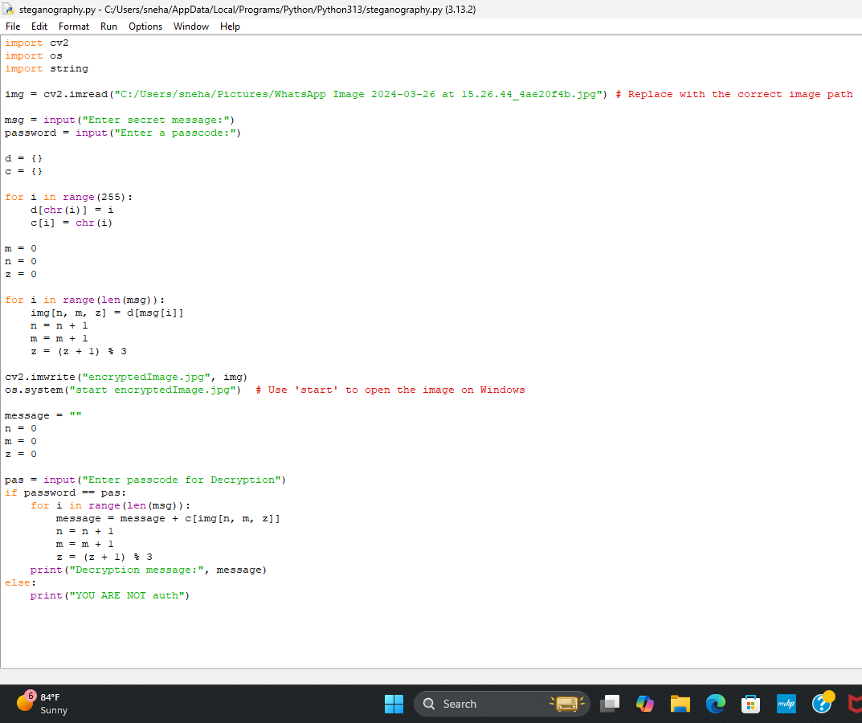
Results

Slide 8
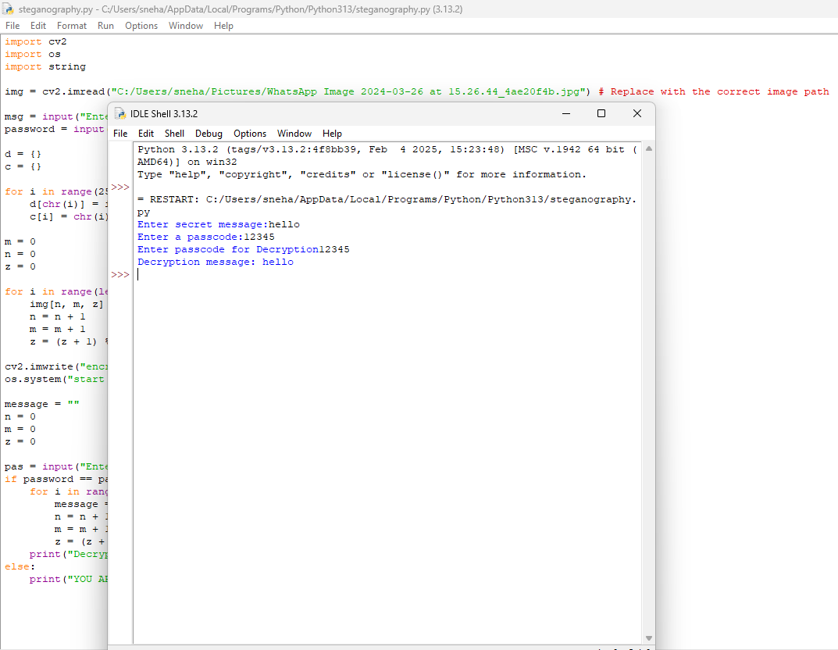

Slide 9
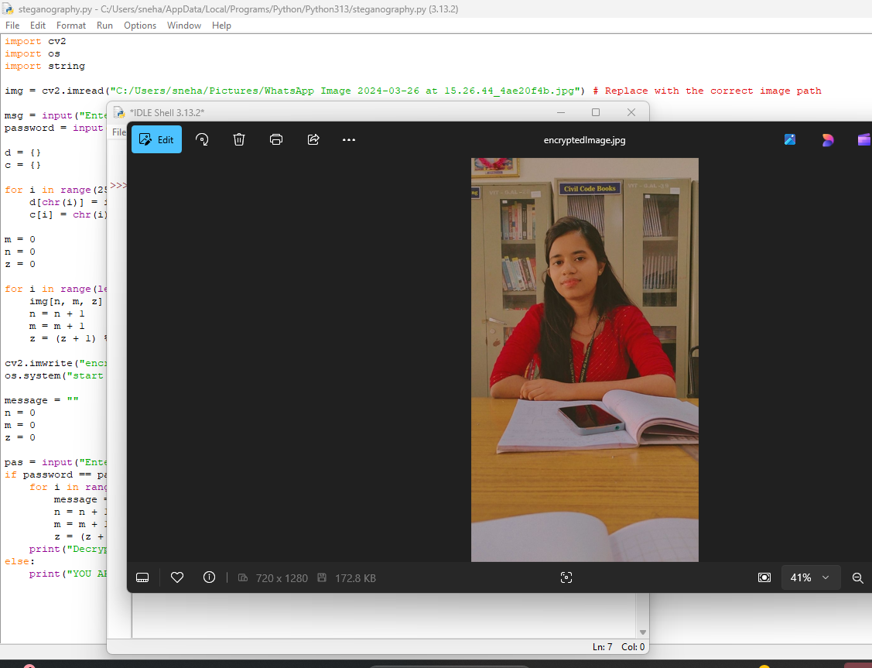

Slide 10
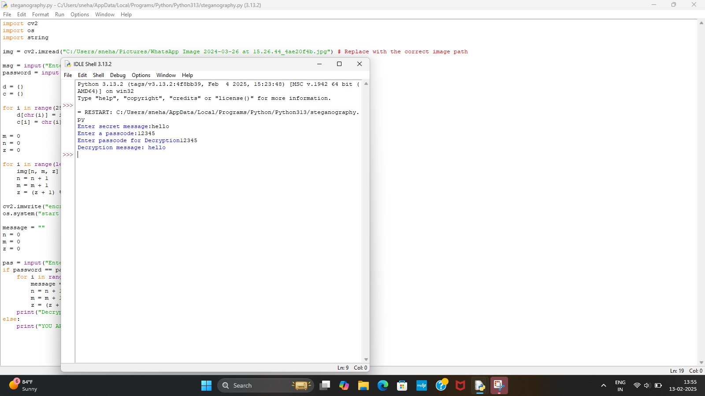

Slide 11
Conclusion
In conclusion, this project demonstrates the effectiveness of steganography in ensuring secure communication and data transfer. The developed system provides a reliable and efficient way to hide secret messages within images, making it a valuable tool for individuals and organizations requiring secure data transfer. Future enhancements can include exploring other steganography techniques, improving the system's security, and expanding its applications.

Slide 12
GitHub Link
https://github.com/snehavj99/secure-data-hiding-in-images-using-stegnography/blob/2e97fabf81cba4bd0017bc32fa8149acab1723c4/README.md

Slide 13
Future scope(optional)
Technological advancements: Exploring audio/video steganography and integrating with other technologies like blockchain and AI.
Security enhancements: Improving system security through enhanced encryption algorithms and password protection.
Industry applications: Expanding the system's use cases to various industries like finance, healthcare, and government.
User experience: Enhancing the user interface for better usability and collaborative editing features.
Steganalysis detection: Developing techniques to detect and prevent steganalysis attacks.These areas of focus will help further develop and refine the steganography system, making it more robust, user-friendly, and widely applicable.

Slide 14
THANK YOU

